Slide 1
Blockchain & Digital Transformation
By: Gheis Mohammadi

Slide 2
Introduction
Background
Overview

Slide 3
Agenda
History of Blockchain
Centralized and Decentralized Networks
Basic Concept of Blockchain
Blockchain Platforms
Basic Concept of Crypto Currencies
Digital Transformation and Blockchain Applications
Markets & Jobs
Future

Slide 4
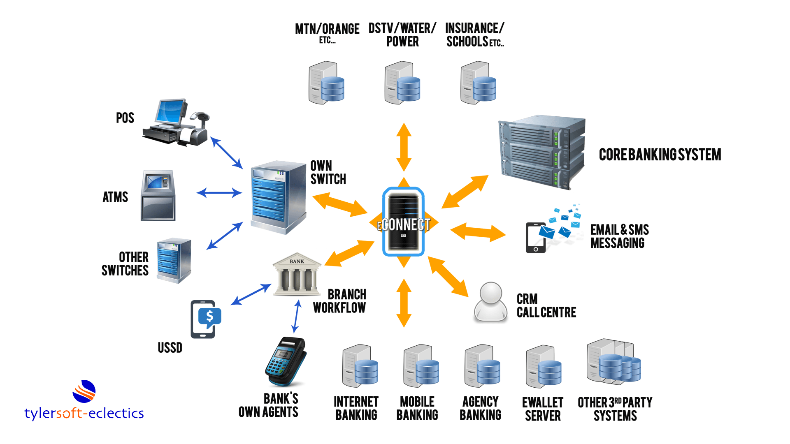
Traditional Banking

Slide 5
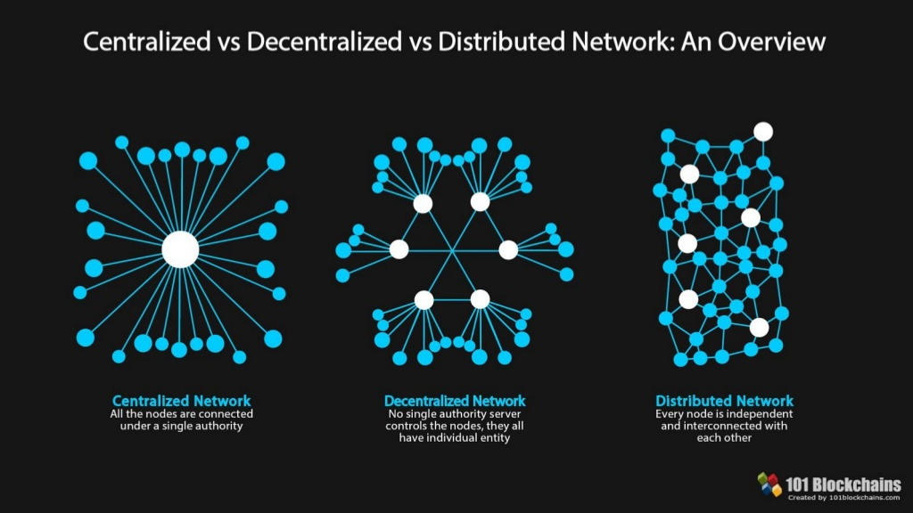

Slide 6
20 years before bitcoin
- Scott Stornetta and Stuart Haber
- Hash functions and digital certificates for time-stamping and certifying digital documents.
- They later came up with the idea of using a distributed network of users to act as certifiers of timestamps, creating decentralized trust.

Slide 7
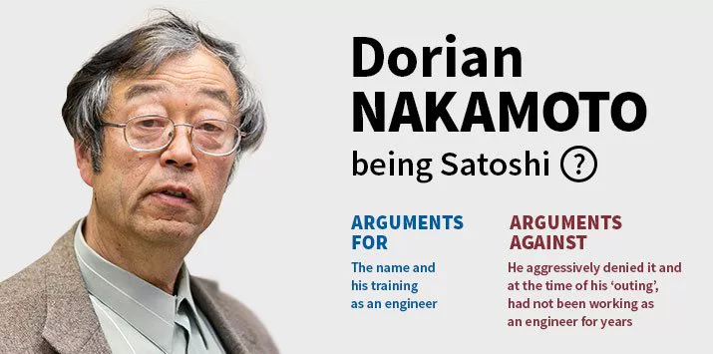
Satoshi Nakamoto

Slide 8

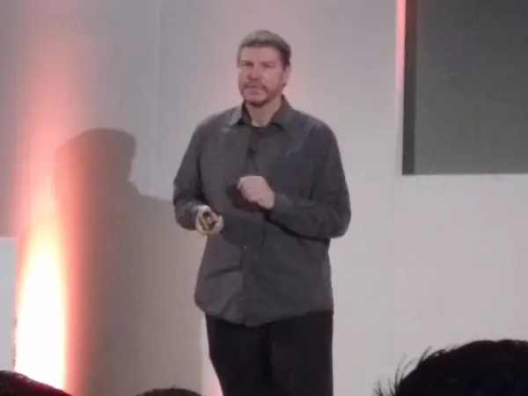
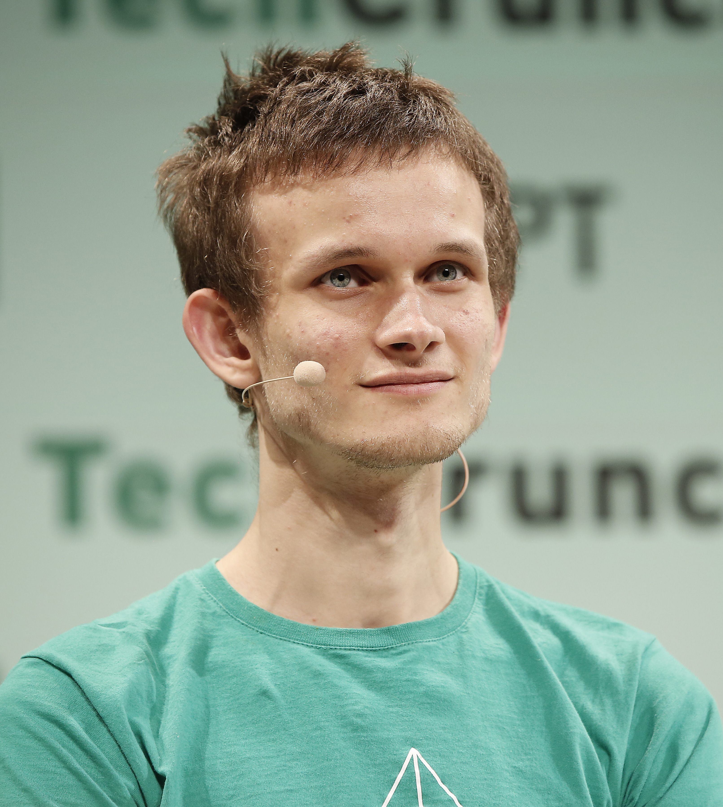
Satoshi Nakamoto
Craig Wright
Nick Szabo
("bit gold" in the late '90s)
"Not Satoshi, but thank you."
Vitalik buterin

Slide 9
Bitcoin Key Highlights
October 31, 2008: Bitcoin white paper published by the anonymous Satoshi Nakamoto.
January 3, 2009: 30,000 lines of C++ code spelled out the beginning of Bitcoin. The Genesis Block is mined.
January 12, 2009: The first Bitcoin transaction.
December 16, 2009: Version 0.2 is released.
In 2010 selling Pizza from a handful of merchants. Today, the amount of bitcoin used to purchase those pizzas is valued over $100 million
November 6, 2010: Market cap value exceeds $1 million USD.
Spring 2011, BitPay, The largest merchant services provider in Bitcoin history began
In 2011, the Silk Road, an online marketplace for illegal drugs, launched. It used bitcoin as its chief form of currency.
On April 23, 2011, Nakamoto sent Bitcoin Core developer Mike Hearn a brief email. “I've moved on to other things,". The future of Bitcoin, he wrote, was "in good hands."

Slide 10
Bitcoin Key Highlights
June 3, 2012: Block 181919 created with 1322 transactions. It is the largest block to-date.
September 27, 2012: Bitcoin Foundation is formed.
2013, Satoshi disappeared
Mt. Gox, The largest exchange collapse in Bitcoin history attracts mainstream media news
December 2017: Bitcoin price reaches its all-time high.
October 31, 2018: 10-year anniversary of Bitcoin.
Dec 2020-April 2021, Tesla Bought $1.5B Bitcoin
Mass adoption

Slide 11
What is Blockchain?
Open, Distributed ledger that can record transactions between two parties efficiently and in a verifiable and permanent way
Permanent and Immutable
Transparent
Reliable
Transactions (Irreversible/Pseudonymous/Fast and global/Secure/Permissionless)

Slide 12
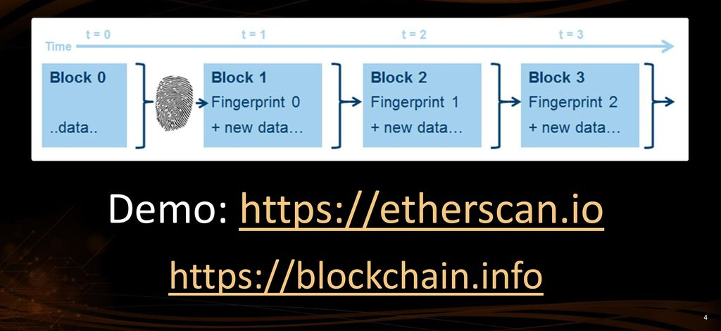
Blockchain == Chain of Blocks

Slide 13
CRYPTOGRAPHY
Converting data into a format that is unreadable for an unauthorized user
In Blockchains:
Initiation and Broadcasting of Transaction
- Digital Signatures
- Private/Public Keys
Validation of Transaction
- Proof of Work and certain alternatives
Chaining Blocks
- Hash Function

Slide 14
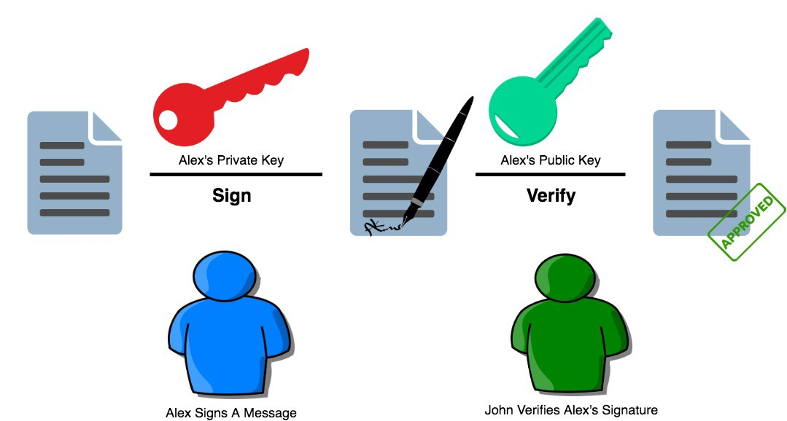
Digital Signature

Slide 15
Mining
Bitcoin miners are nodes in the Bitcoin network that possess specialized software technology called ASICs.
The Bitcoin miners constantly solve crypto graphically hard puzzles.
If successful, they get to add a block to the Bitcoin blockchain and get a reward, in return.
Currently, the bitcoin block reward is around 6.25 BTC.

Slide 16
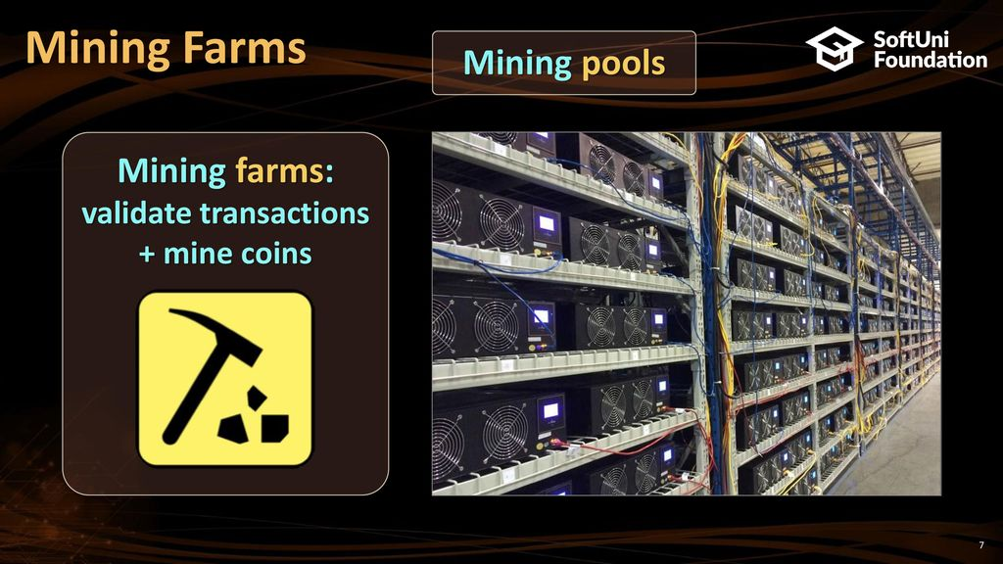

Slide 17
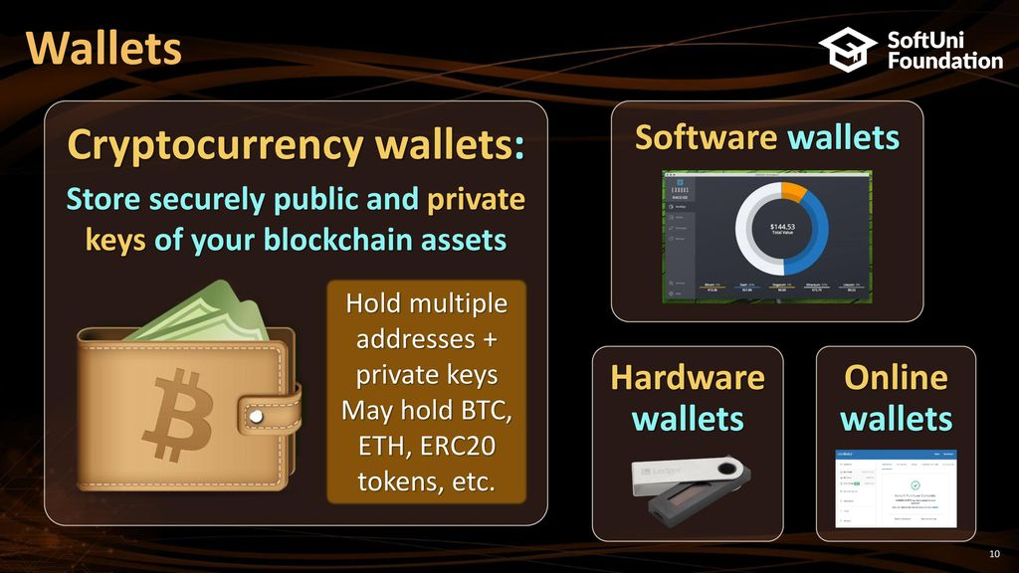

Slide 18
Characteristics
“White papers” often address key questions
Public Blockchains vs Private Blockchains
Permissioned vs Permissionless
One ledger or Segregated ledgers
Sharding (Watch debate: Alex Skidanov, CEO of NEAR Protocol and Anatoly Yakovenko, CEO of Solana)
Validation Methodology (depends on degree of trust between nodes.)
Consensus Mechanism (depends on degree of trust between nodes)
Interfaces/programming language
Supporting Smart Contracts
Reward and Staking

Slide 19
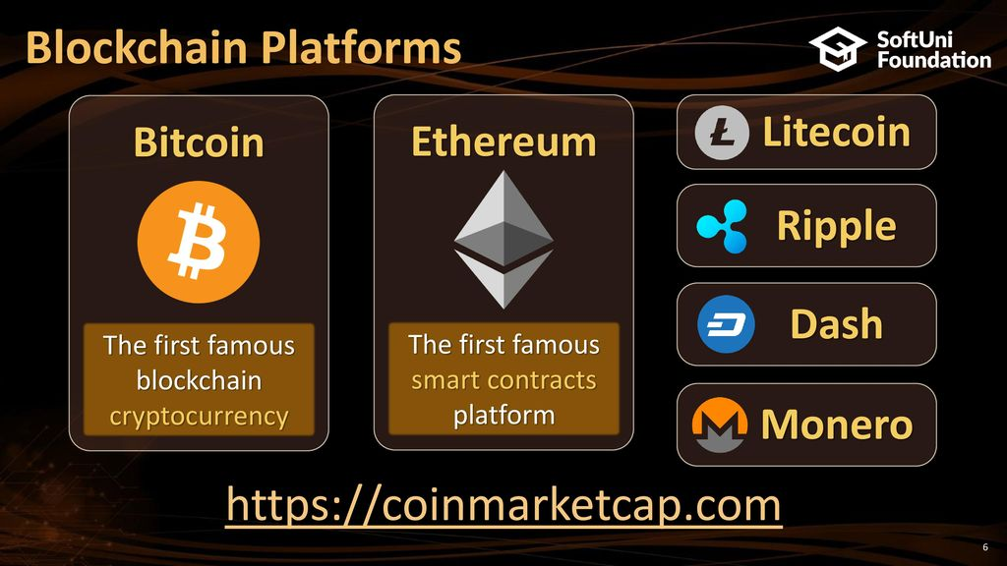

Slide 20
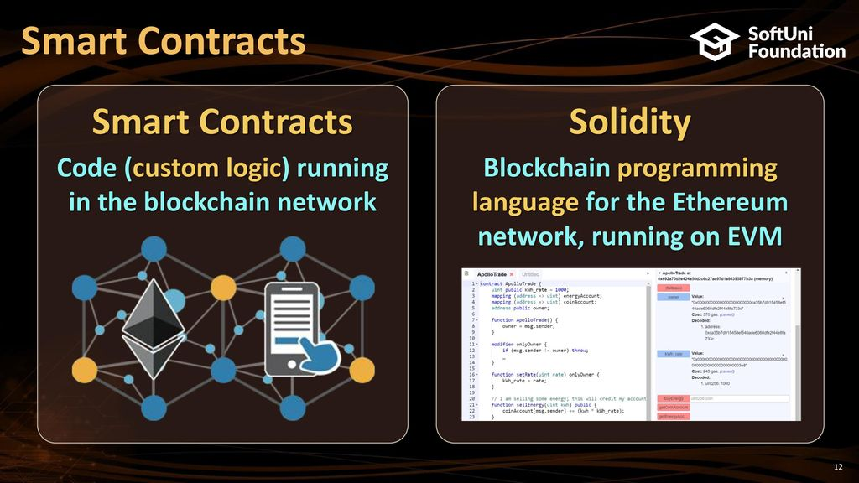

Slide 21
smart contract programming
Solidity
Ethereum, Tendermint, Binance Smart Chain, Ethereum Classic, Tron, Avalanche, CounterParty, and Hedera.
Rust
Solana, Polkadot, Near
Javascript
Hyperledger Fabric
Vyper
- Similar to Python
Yul
- Most Ethereum-based projects most likely already use Yul
Move
- Aptos

Slide 22
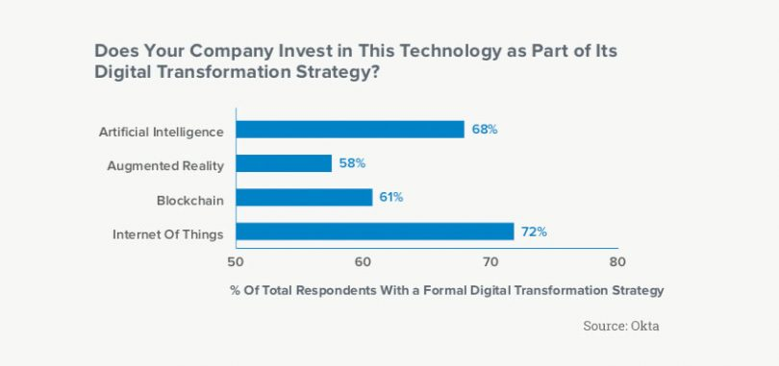
Digital Transformation

Slide 23
Digital Transformation & Blockchain
Blockchain is part of digital transformation strategy for over 61% of enterprises
At least 61% of the global 2000 will use blockchain services as a foundation for digital trust at scale
Nearly 6 in 10 large corporations are either actively considering, or are in the process of, deploying blockchain technology
Blockchain have many potential applications rather than financial services industry
Zero Trust

Slide 24
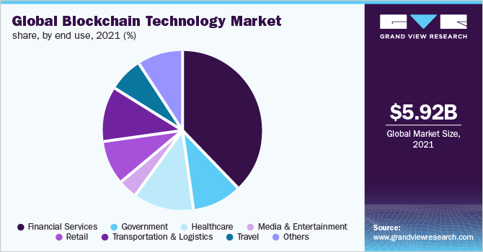
Digital Transformation

Slide 25
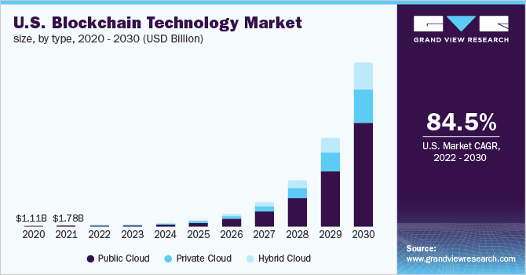
Digital Transformation

Slide 26
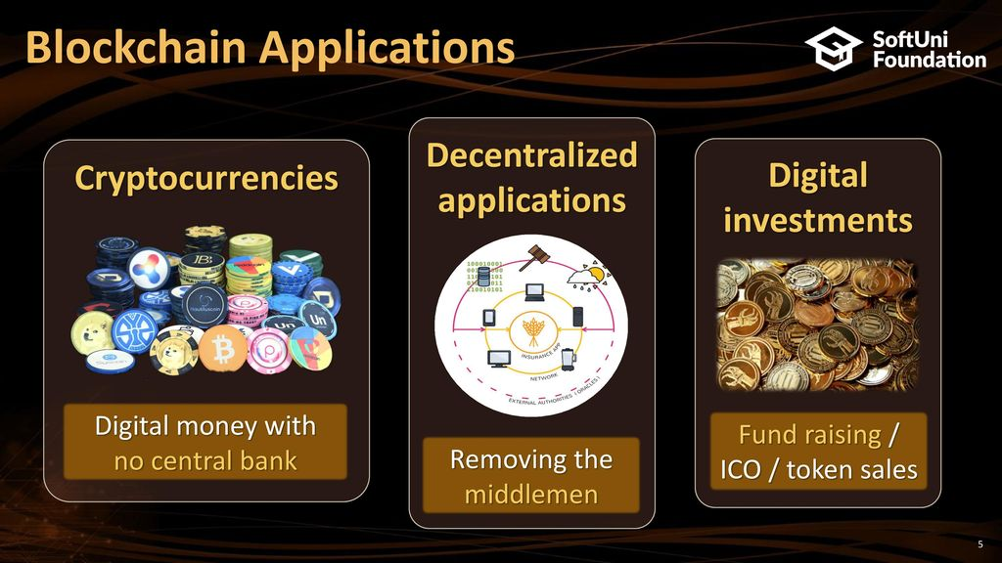
Applications

Slide 27
High Demand Markets
Supply Chains
Education
Healthcare
Insurance
IOT
Investing
Digital Assets & Bonds
Digital Banking & Payments
Game Industry
Data Management

Slide 28
Government and Blockchain
Benefits
Time
Cost
Risks of managing sensitive information
Providing an immutable and transparent audit trail for regulatory compliance, contract management, identity management and citizen services.

Slide 29
Tax
Transparency, Efficiency, Data integrity, and security, can benefit the tax administration in multiple ways
decentralization can improve efficiency and the interaction between multiple actors
Blockchain could help address this problem as it allows information to be captured from many perspectives
Micro payment ( example: Bitcoin Lightning Network)

Slide 30
Islamic Economy
WAQF
Sukok

Slide 31
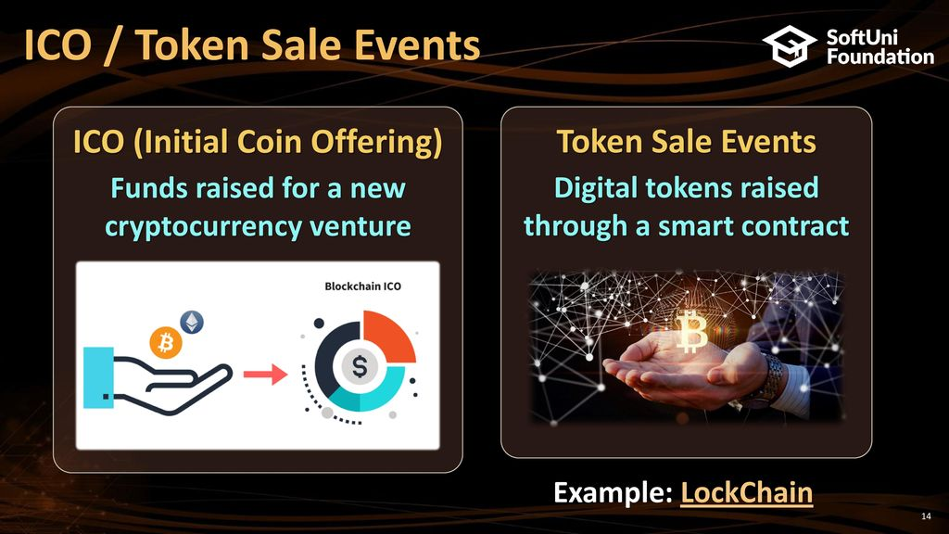

Slide 32
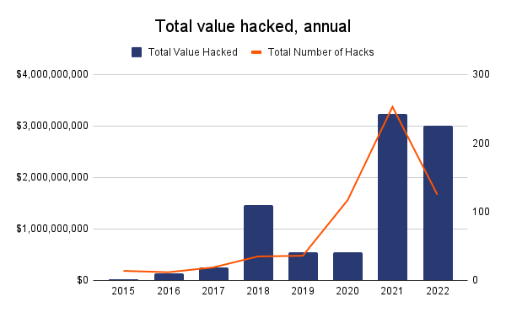

Security
- Story of John McAfee
47, 61, $5.42B, 250K

Slide 33
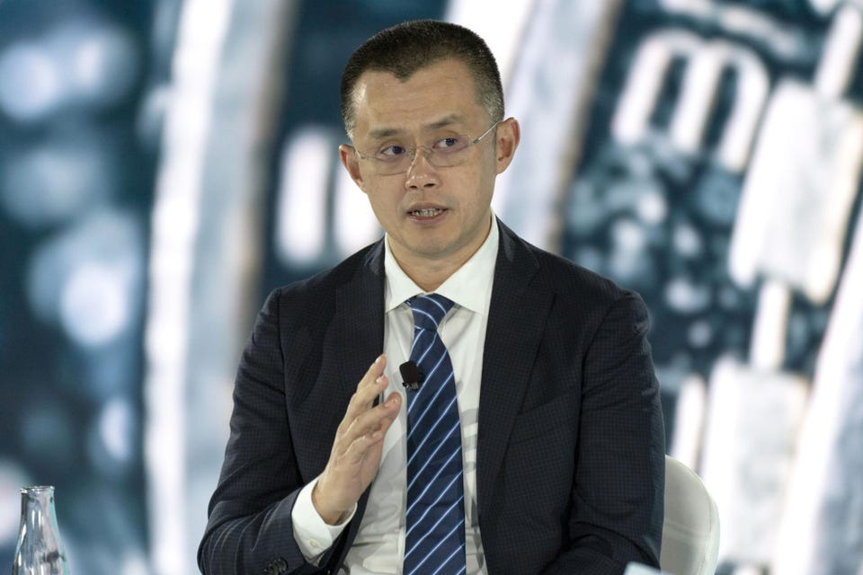
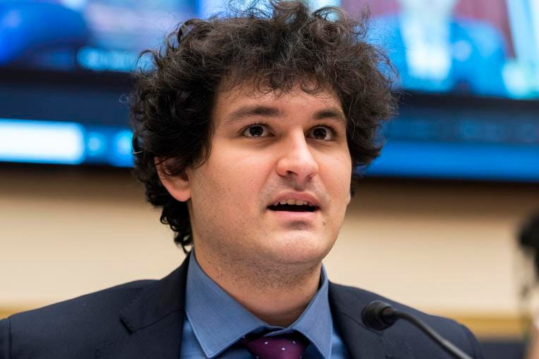
crypto’s billionaire club
Changpeng Zhao (44 years old)
Net worth: $65 billion
Source of wealth: Binance
Citizenship: Canada
Sam Bankman-Fried (SBF)
30 years old
Net worth: $24 billion
Source of wealth: FTX
Citizenship: U.S.
(Gary Wang – $5.9B)

Slide 34
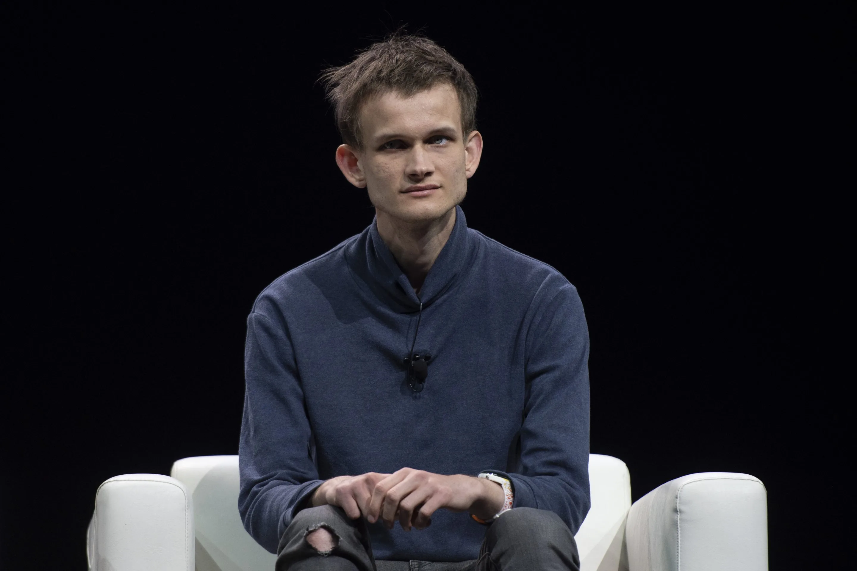
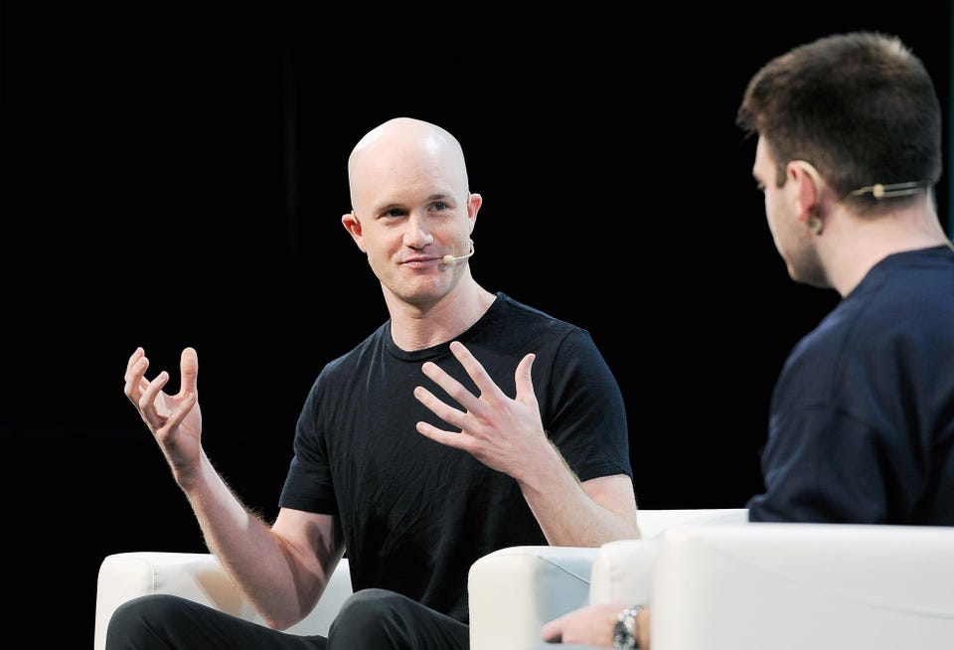
crypto’s billionaire club
Brian Armstrong
Net worth: $6.6 billion
Source of wealth: Coinbase
Citizenship: U.S.
Vitalik Buterin (28 years old)
290,000 Ethereum
Net worth: $1B

Slide 35

Negatives
Dark Web / Drugs / Gambling / Money Laundering
CryptoKitties
CryptoKitties is a game,
collectible!
Each cat is one-of-a-kind and 100% owned by you;
it cannot be replicated, taken away, or destroyed.
Market Cap: $20M in 2018

Slide 36
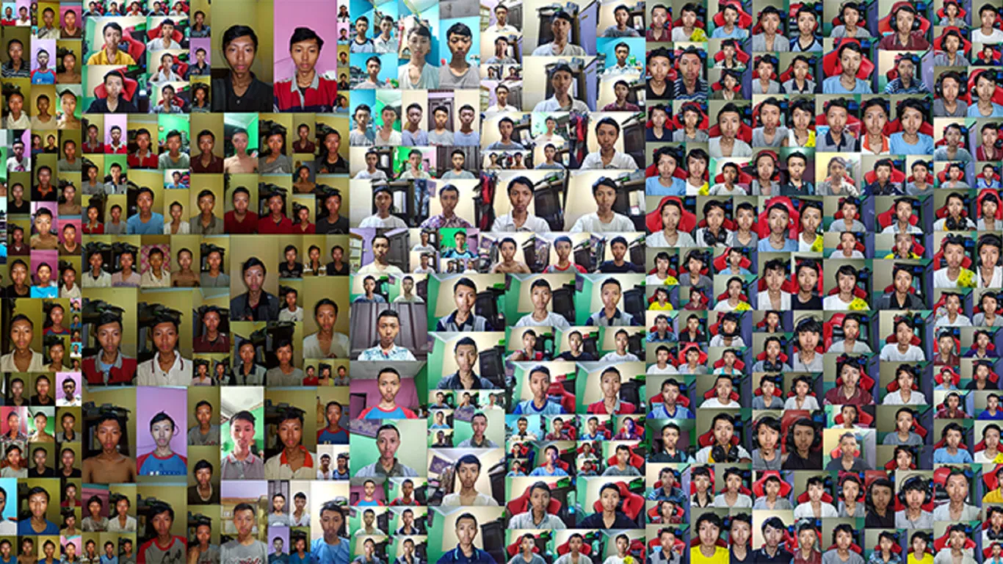

NFT (ERC721)
What is NFT ?
'Ghozali Everyday'

Slide 37
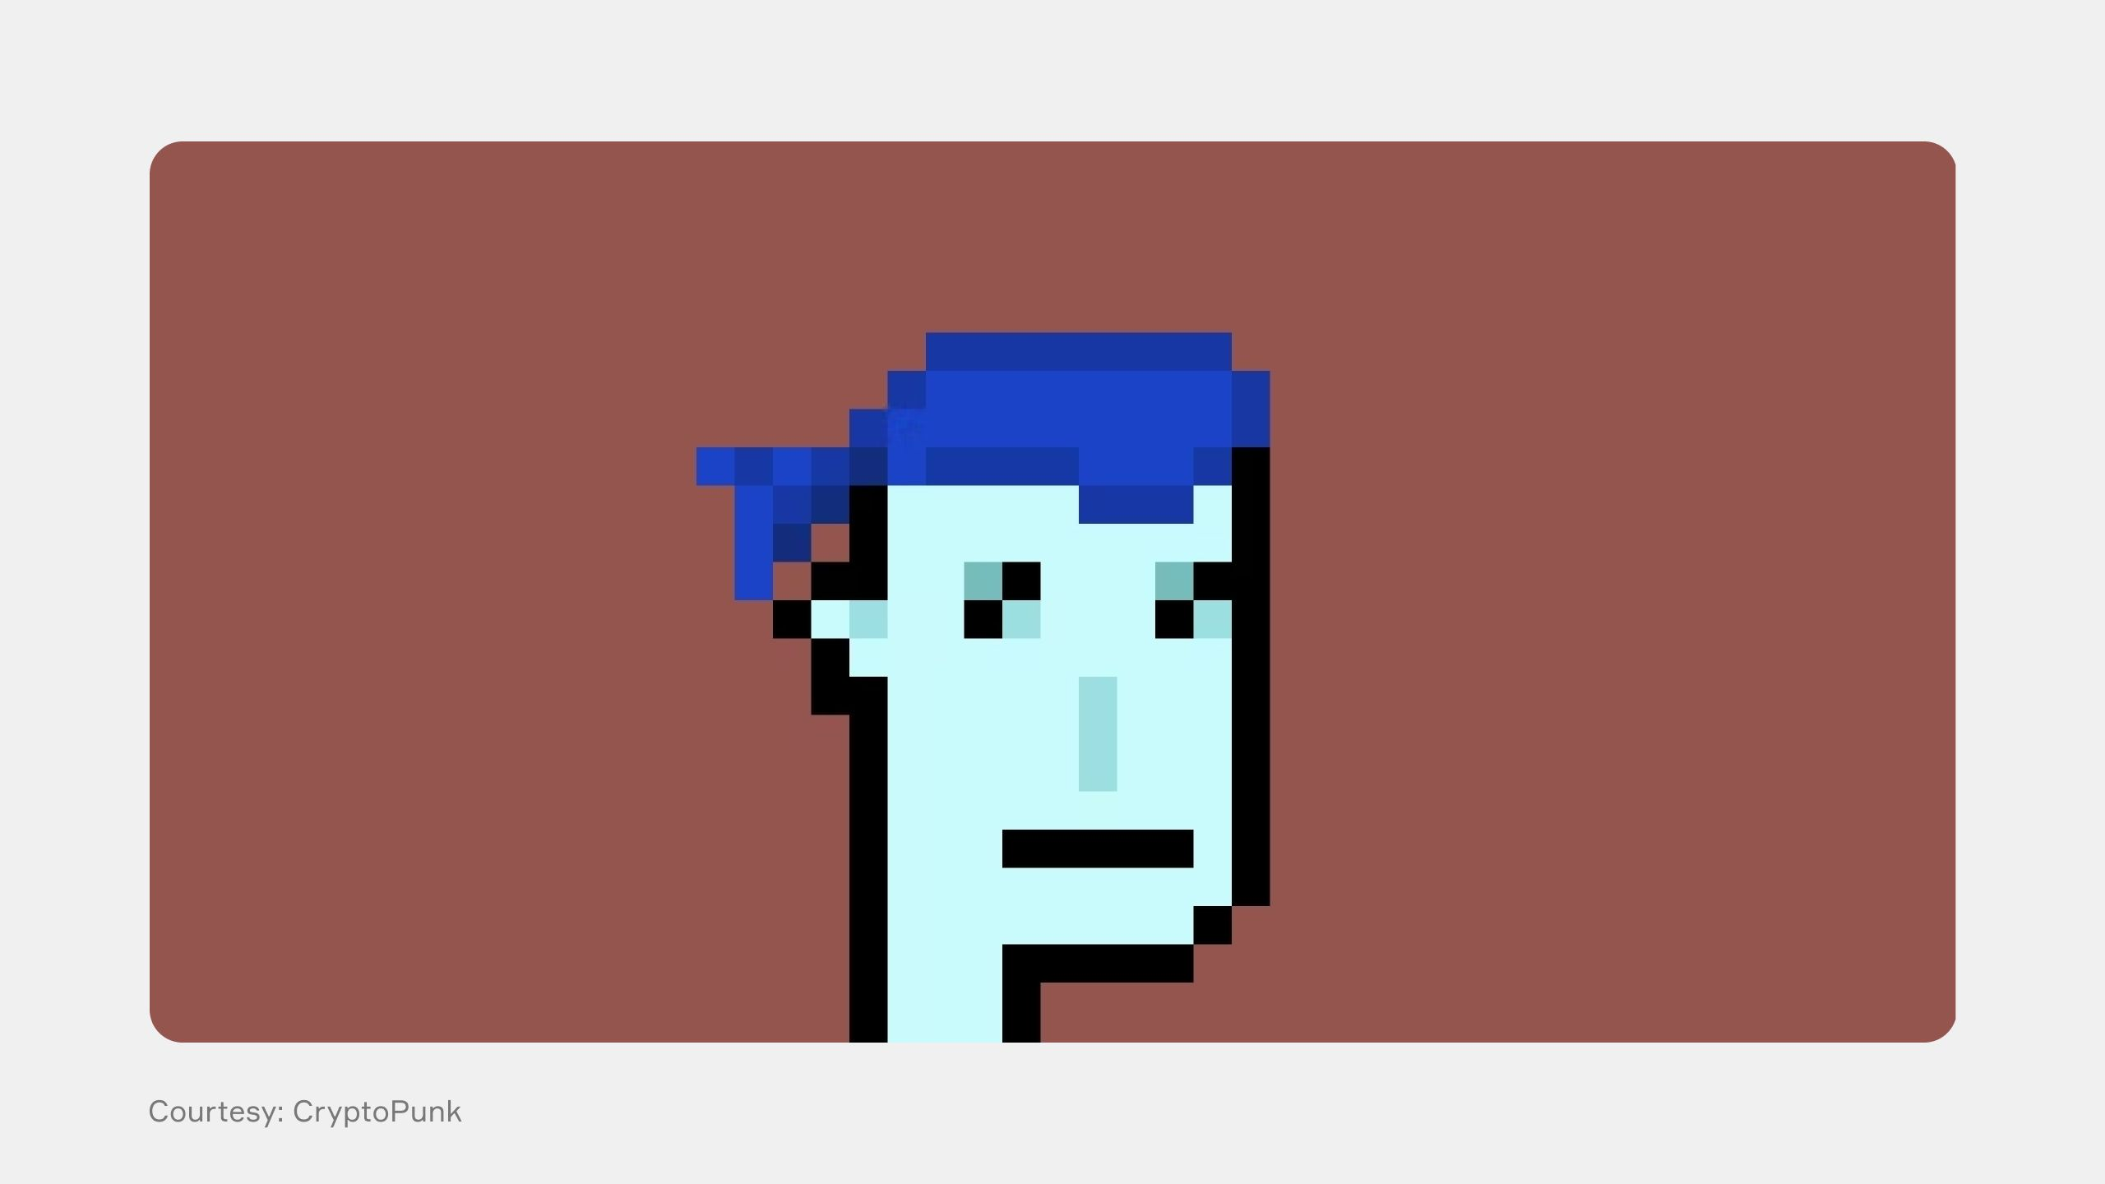
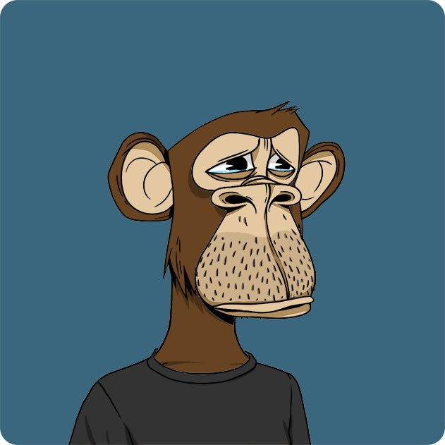
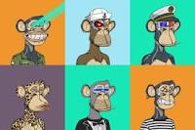
Weird NFT Sold
Jack Dorsey’s First Tweet
- “just setting up my twttr”
Sina Estavi (Oracle CEO)
$2.9M
$48M/$2.9M → $280/$6,800
Beeple’s (Mike Winkelmann) Trump corpse
2020, $66,666.60 → $6.6M
CryptoPunk - $23.7 million
10,000 24x24 pixel art images
Bored Ape (10,000)
?
Justin Bieber $1.31M

Slide 38
Blockchain Jobs
Startup (?)
Developer & Engineer ($135,000 - $200,000+ per year)
Core developer
Tools
DApps & Smart Contracts
Adviser ($56,000 – $107,000 per year)
Audit ($120,000 and above)
Certik (net worth: $2B)
Solution & Designer (?)

Slide 39
High Salaries
Increased demand and short supply
Technology is on everyone’s radar
Established firms have embraced blockchain and announced initiatives
Microsoft Corp. (MSFT) has started a blockchain-as-a-service (BAAS) platform within Azure, its cloud division
IBM Corp. (IBM) has also launched a division dedicated to blockchain, basing it on an open-source fabric Hyperledger.
Social media behemoth Facebook Inc. (FB) has formed a group to explore blockchain’s uses in its business.
Hundreds of DeFi projects and Marketplaces
A shortage in skills supply has helped further inflate salaries for blockchain experts.
Several new initiatives are being launched to plug the gap in supply, from bounty programs to encourage developers to boot camps introducing the technology to developers.
Universities are also in on the game and have launched online courses to educate professionals.

Slide 40
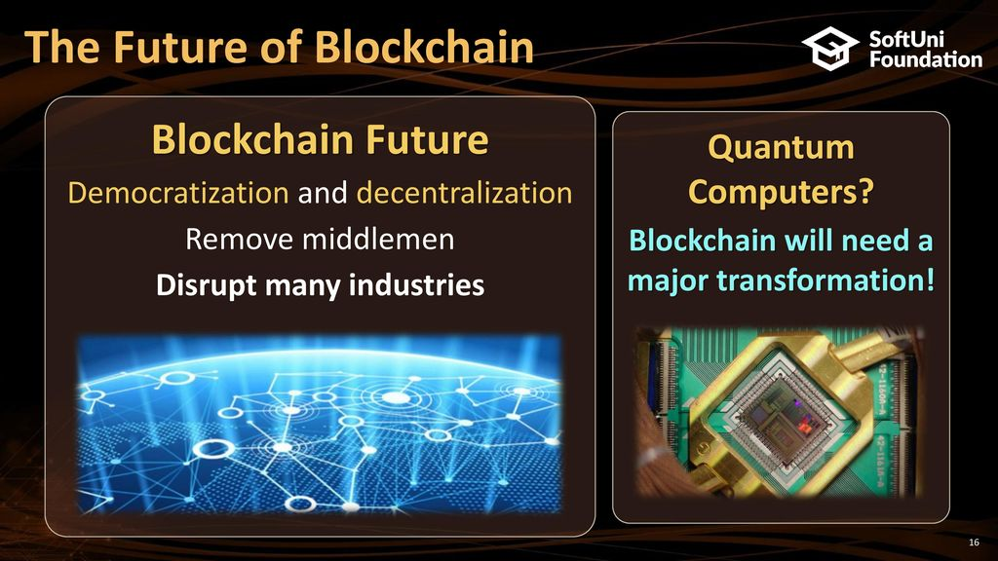

Slide 41
Looking ahead to 2023
a lack of understanding could very well lead to risk for governments and companies in the future.
move to the next generation of web development are going to need to get into cryptocurrency
adoption of crypto and stablecoins
Asia is a hot spot for crypto infrastructure, stablecoins and the CeFi/DeFi market.
100% to 150% growth in crypto adoption in Asia.
TRON, for example, is handling around 10 million transactions every day, with around 5 to 6 million active users
decentralized identity (dID)
soulbound items (SBT)
powerful items that cannot be transferred or sold to other players after a user picks it up
his technology will soon be implemented by countries around the world and create a more compliant and robust system

Slide 42


